Slide 1

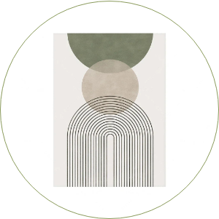
Sustainable Aesthetics
CONCEPT OVERVIEW

Slide 2

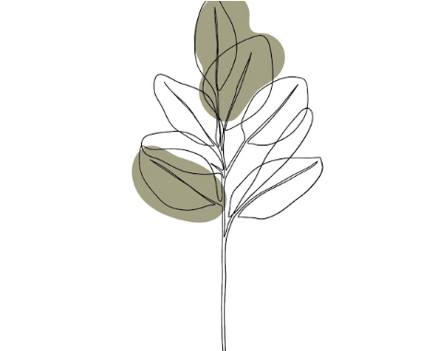
Defining the Concept
Sustainable Aesthetics is not merely a design trend; it is a philosophy that harmonizes ethical production with visual purity. It seeks to prove that luxury and responsibility are not mutually exclusive.
At its core, it embraces the "Fine Line" approach—delicate, intentional, and stripped of excess—mirroring the fragility and resilience of our natural world.

Slide 3
"The details are not the details. They make the design. In sustainability, the details are the materials, the process, and the lifespan."
CHARLES EAMES (ADAPTED)

Slide 4




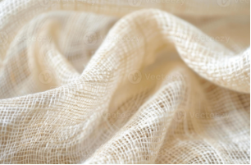

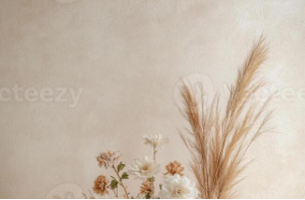

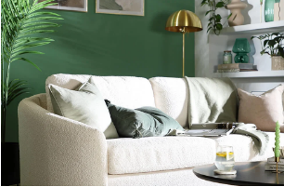
Nature's Palette
Raw Linen
Dried Flora
Recycled Clay
Unbleached, breathable, and fully biodegradable. A staple of slow living.
Celebrating the beauty of decay and longevity over fresh cut waste.
Earth-toned ceramics that ground a space in history and texture.

Slide 5
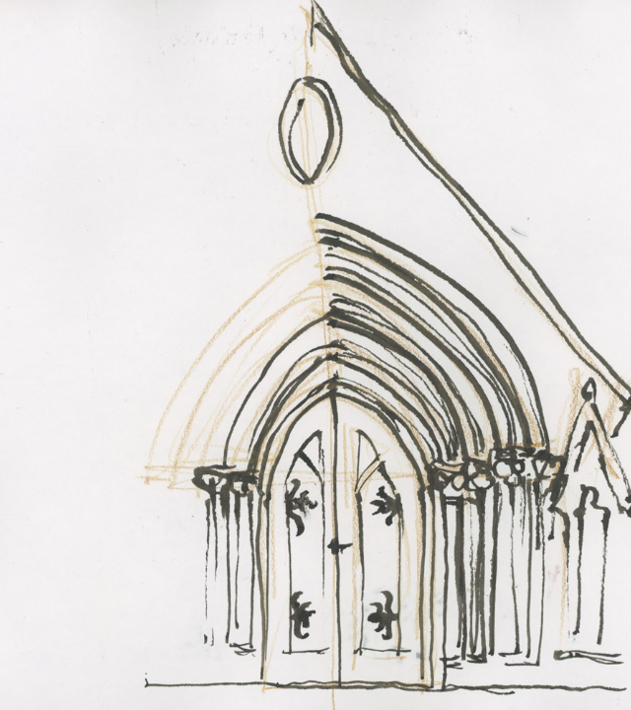
The Architectural Arch
The arch represents the perfect marriage of structural integrity and organic softness. In sustainable design, it minimizes material usage while maximizing load-bearing capacity.
Soft transitions: Moving away from rigid, industrial corners.
Flow: Creating spaces that breathe and connect.
Timelessness: A form that has endured for millennia, defying trends.

Slide 6

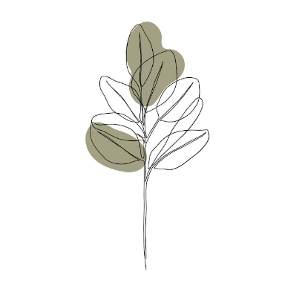
The "Fine Line" Technique
Why Thin Lines?
Thick, bold lines often denote permanence and industrial weight. Fine lines, however, suggest:
Transparency: Nothing is hidden; the structure is laid bare.
Lightness: A reduced visual footprint mimicking a reduced carbon footprint.
Elegance: High-end aesthetics often rely on the subtlety of the stroke.

Slide 7






Calm & Restoration
Sand Beige
Sage Green
Deep Olive
Grounding, neutral, and warm. Evokes sand, stone, and unbleached paper.
Restorative, balanced, and natural. The bridge between the indoors and outdoors.
Depth, heritage, and focus. Provides the necessary contrast for readability.

Slide 8
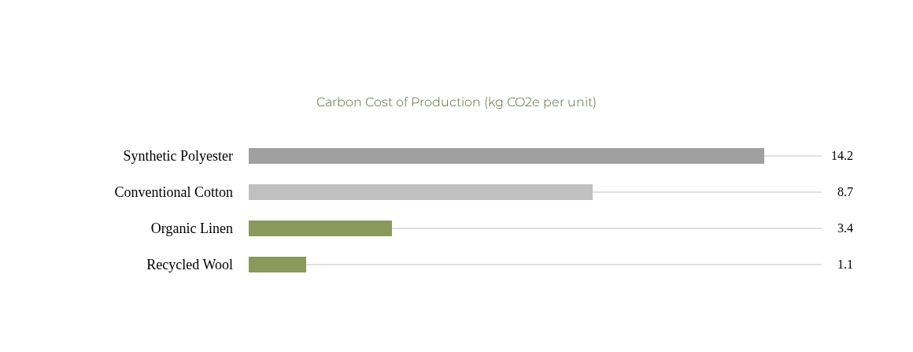
Environmental Footprint

Slide 9






The Future: Regenerative Design
Bio-Materials
Circularity
Slow Manufacturing
Furniture grown from mycelium (mushrooms) and algae-based bioplastics.
Design for disassembly. Every component can be returned to the earth or the factory.
A return to artisanal, made-to-order production models to eliminate excess inventory.

Slide 10



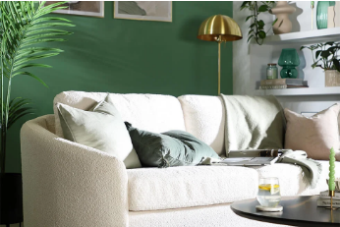
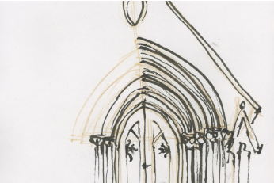
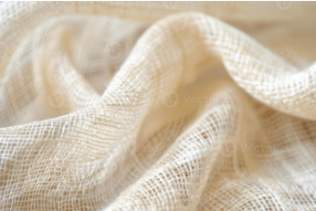
Moodboard

Slide 11
Living with Intention
Sustainable aesthetics invites us to pause, reflect, and choose well. It creates spaces that not only look beautiful but feel right.

Slide 12
Questions?
Thank you for your time.

Slide 13






Image Sources
https://nordicwallart.com/cdn/shop/files/S475399af4eb843d7952e68cfe295a3fcY.webp?v=1716235024&width=1920
Source: nordicwallart.com
https://img.freepik.com/free-vector/hand-drawn-one-line-art-plant-illustration_23-2149257880.jpg
Source: www.freepik.com
https://static.vecteezy.com/system/resources/previews/046/838/288/large_2x/natural-beige-textured-raw-linen-fabric-close-up-for-design-craft-home-decoration-or-fashion-projects-photo.jpg
Source: www.vecteezy.com
https://static.vecteezy.com/system/resources/previews/054/963/465/non_2x/ceramic-vases-in-white-and-beige-showcase-dried-pampas-grass-and-neutral-toned-flowers-the-composition-emphasizes-a-modern-organic-aesthetic-on-a-minimal-backdrop-photo.jpg
Source: www.vecteezy.com
https://images.ctfassets.net/x715brg11yrw/4LXBhhvA0Tf9S9B2nZhunY/a5ad506e93656890bbbcaa018bf44c9b/Cream_living_room_with_sage_green_feature_wall.jpg?w=1800&fm=webp&q=80
Source: www.furniturechoice.co.uk
https://www.lizsteel.com/wp-content/uploads/2024/06/LizSteel-184-StGeorgesfrontdoor2.jpg
Source: www.lizsteel.com

